Slide 1
Knowledge
Unit-4

Slide 2
Logical Agents,
Knowledge-Based Agents,
The Wumpus World,
Logic,
Propositional Logic: A Very Simple Logic, Propositional Theorem Proving,
Effective Propositional Model Checking,
Agents Based on Propositional Logic,
First-Order Logic,
Representation Revisited,
Syntax and Semantics of First-Order Logic,
Using First-Order Logic,
Knowledge Engineering in First-Order Logic.

Slide 3
Motivation of Knowledge-Based Agents
Humans know things and do reasoning, which are important for artificial agents
Knowledge-based agents benefit from knowledge expressed in general forms, combining information to suit various purposes
Knowledge and reasoning is important when dealing with partially observable environments
Understanding natural language requires inferring hidden states
Flexibility for accepting new tasks

Slide 4
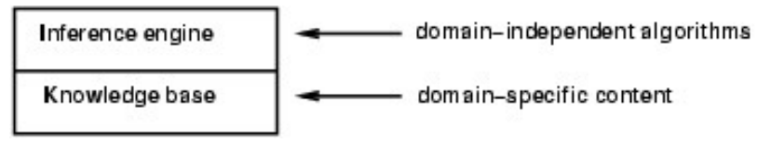
Knowledge Bases
Knowledge base = set of sentences in a formal language
Declarative approach to building an agent (or other system):
Tell it what it needs to know
Then it can Ask itself what to do - answers should follow from the KB
Both “Tell” and “Ask” involve inference – deriving new sentences from old

Slide 5
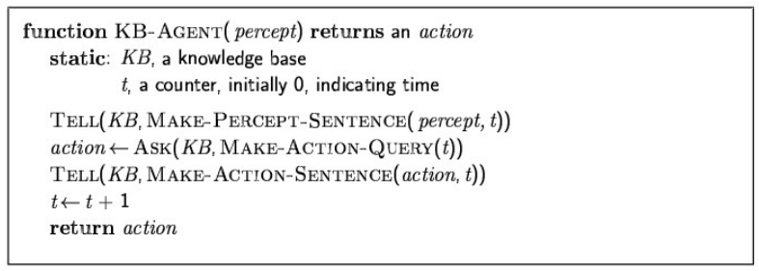
A Simple Knowledge-Based Agent
Agents can be viewed at the knowledge level i.e., what they know, regardless of how they are implemented
Or at the implementation level
i.e., data structures in KB and algorithms that manipulate them

Slide 6
Agent’s Requirements
The agent must be able to:
Represent states, actions, etc.
Incorporate new percepts
Update internal representations of the world
Deduce hidden properties of the world
Deduce appropriate actions

Slide 7
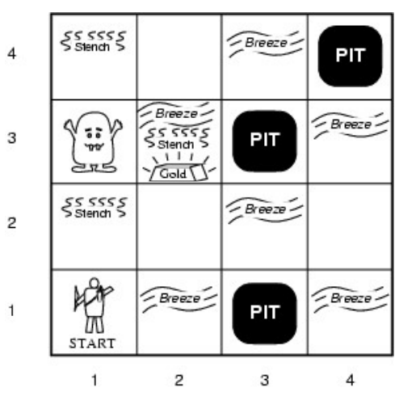
Our New Toy Problem – Wumpus World

Slide 8
The rooms adjacent to the Wumpus room are smelly, so that it would have some stench.
The room adjacent to PITs has a breeze, so if the agent reaches near to PIT, then he will perceive the breeze.
There will be glitter in the room if and only if the room has gold.
The Wumpus can be killed by the agent if the agent is facing to it, and Wumpus will emit a horrible scream which can be heard anywhere in the cave.

Slide 9
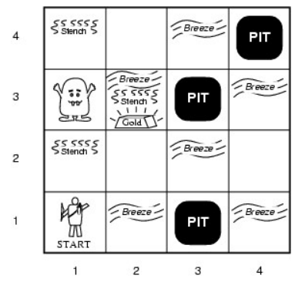
Wumpus World PEAS
Performance measure
gold +1000, death -1000
-1 per step, -10 for using the
arrow
Environment
4x4 grid of rooms
Agent always starts at [1,1]
Wumpus and gold randomly chosen
Each square other than start is pit with 0.2 probability

Slide 10
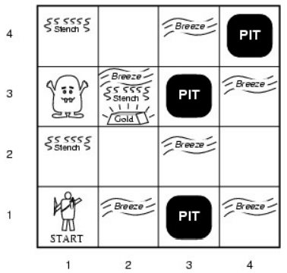
Actuators: Left turn, Right turn, Forward, Grab, Release, Shoot, Climb
Shooting kills wumpus if you are facing it
Shooting uses up the only arrow
Grabbing picks up gold if in same
square
Releasing drops the gold in same
square
Climbing out of the cave from [1, 1]
Sensors (percepts): Stench, Breeze,
Glitter, Bump, Scream
Squares adjacent to wumpus are
smelly
Squares adjacent to pit are breezy
Glitter iff gold is in the same square
Bump when agent walks into a wall
When wumpus is killed, it screams

Slide 11
Fully observable?
No – only local perception
Deterministic?
Yes – outcomes exactly specified  Episodic?  No – sequential at the level of actions  Static?  Yes – Wumpus and Pits do not move  Discrete?  Yes  Single-agent?  Yes – Wumpus is essentially a natural feature

Slide 12
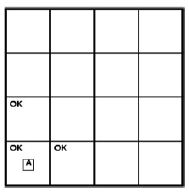
Exploring a Wumpus World
Agent’s initial knowledge base contains the rules of the environment: it knows that
it’s at [1,1] and it’s safe at [1,1]
percept: [none, none, none, none, none]

Slide 13
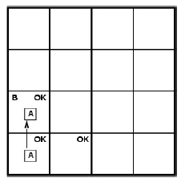
Exploring a Wumpus World
percept: [none, breeze, none, none, none]

Slide 14
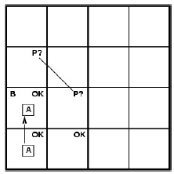
Exploring a Wumpus World
percept: [none, breeze, none, none, none]

Slide 15
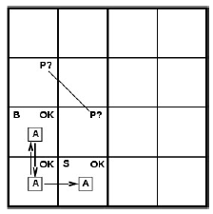
Exploring a Wumpus World
our cautious agent will go back and to [2,1]

Slide 16
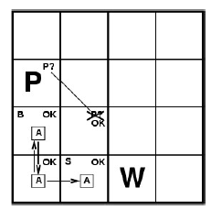
Exploring a Wumpus World
percept: [stench, none, none, none, none]

Slide 17
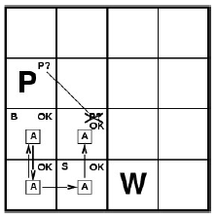
Exploring a Wumpus World
percept: [none, none, none, none, none]

Slide 18
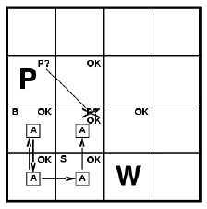
Exploring a Wumpus World
percept: [none, breeze, none, none, none]

Slide 19
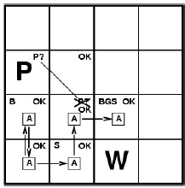
Exploring a Wumpus World
percept: [stench, breeze, glitter, none, none]

Slide 20
Logical Reasoning
In each case where the agent draws a conclusion from the available information, that conclusion is guaranteed to be correct if the available information is correct
■ The above is the fundamental of logical reasoning

Slide 21
Logic in General
Logics are formal languages for representing information such that conclusions can be drawn
Syntax defines the sentences in the language
Semantics define the "meaning" of sentences;
i.e., define truth of a sentence in a world
E.g., the language of arithmetic
x+2 ≥ y is a sentence; x2+y > {} is not a sentence
x+2 ≥ y is true if the number x+2 is no less than the number y
x+2 ≥ y is true in a world where x = 7, y = 1
x+2 ≥ y is false in a world where x = 0, y = 6

Slide 22
Entailment
Now, we have a notion of truth, we are ready to study logical reasoning, which involves logical entailment between sentences
Entailment means that one thing follows from another:
KB ╞ α
Knowledge base KB entails sentence α if and only if α is true in all worlds where KB is true
E.g., the KB containing “the Giants won” and “the Reds won” entails “Either the Giants won or the Reds won”
E.g., x+y = 4 entails 4 = x+y
Entailment is a relationship between sentences (i.e., syntax) that is based on semantics

Slide 23
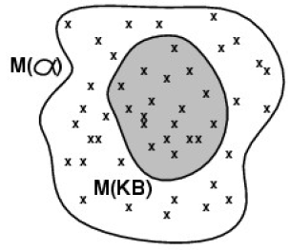
Models
We use the term “model” to represent “possible world”
We say m is a model of a sentence α if α is true in model m
M(α) is the set of all models
of α
Then
E.g. KB = Giants won and Reds
won, α = Giants won

Slide 24
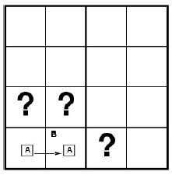
Entailment in the Wumpus World
Situation after detecting
nothing in [1,1], moving
right, breeze in [2,1]
■ Consider possible models
for KB assuming only pits
■ 3 Boolean choices  8
possible models

Slide 25
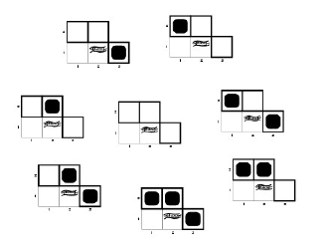
Wumpus Models

Slide 26
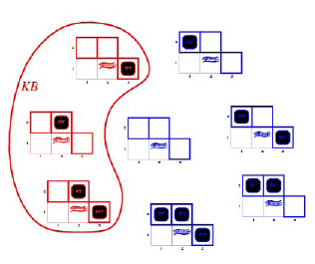
KB = wumpus-world rules + observations

Slide 27
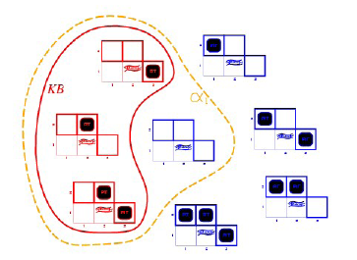
KB = wumpus-world rules + observations
α1 = "[1,2] is safe", KB ╞ α1, proved by model checking
enumerate all possible models to check that α is true in all models in
which KB is true

Slide 28
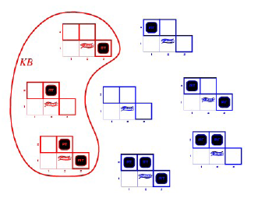
KB = wumpus-world rules + observations

Slide 29
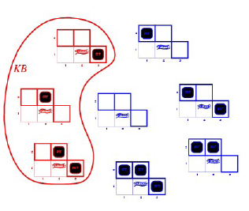
KB = wumpus-world rules + observations
α2 = "[2,2] is safe“, KB ╞ α2?

Slide 30
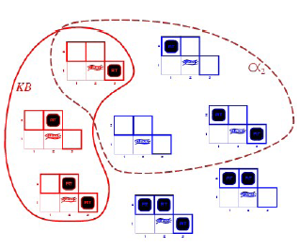
KB = wumpus-world rules + observations
α2 = "[2,2] is safe", KB ╞ α2

Slide 31
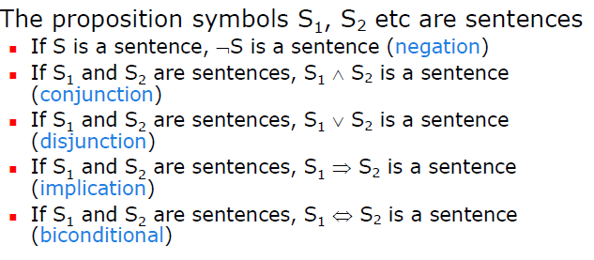
Propositional Logic: Syntax
Propositional logic is the simplest logic – illustrates
basic ideas

Slide 32
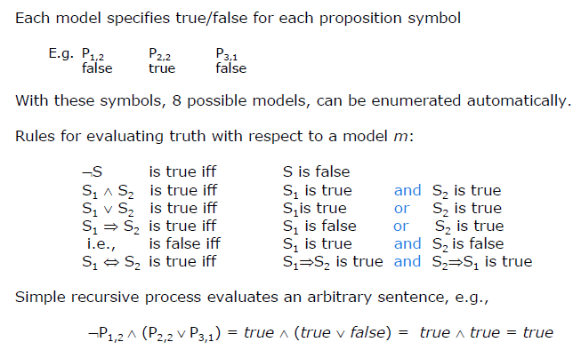

Slide 33
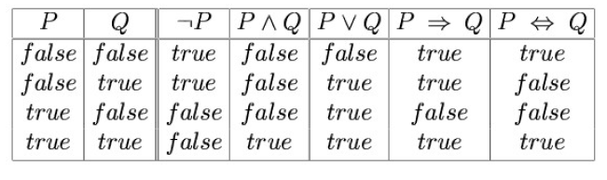
Truth Tables for Connectives

Slide 34
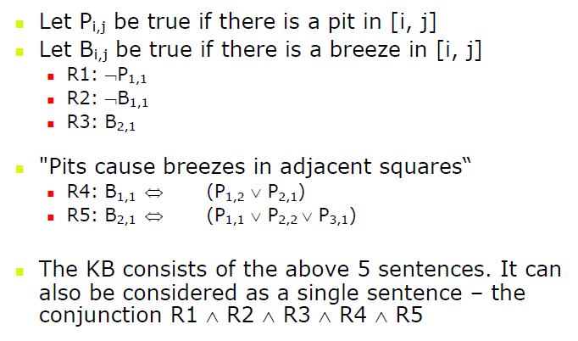
Wumpus World Sentences

Slide 35
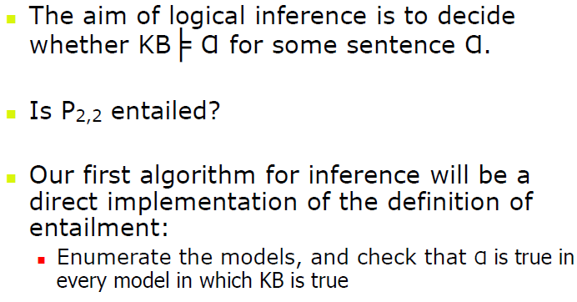
Inference

Slide 36
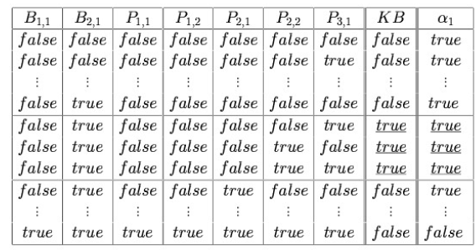
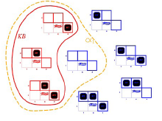
Truth Tables for Inference
P1,2 is false, cannot decide on p2,2
α1 = "[1,2] is safe"

Slide 37
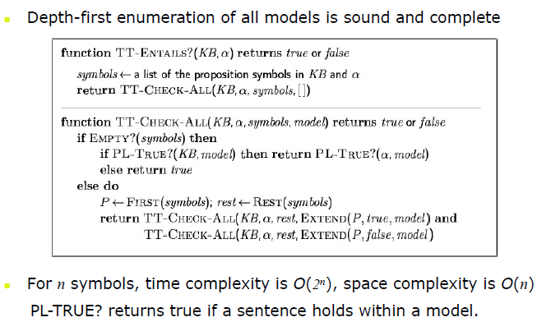
Inference by Enumeration

Slide 38
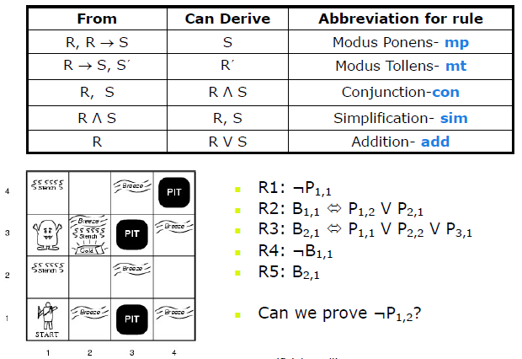
Inference Rules

Slide 39
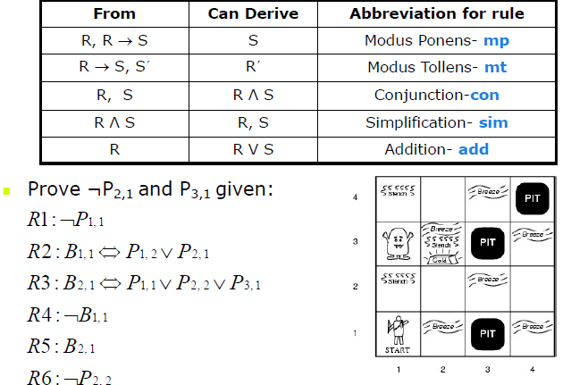

Slide 40
Proof Problem as Search Problem
Initial state: initial knowledge base
Actions:
set of actions consists of all the inference rules applied to
all the sentences that match the left half of the inference rule
Result: add the sentence in the right half of the inference rule
Goal: the goal is a state that contains the sentence we are trying to prove
Practically, finding a proof can be more efficient because the proof can ignore irrelevant propositions, no matter how many of them there are

Slide 41
Resolution
The inference rules can be applied whenever suitable premises are found in the KB
The conclusion of the rule must follow regardless of what else is in the KB
The above rules are sound, but if the available inference rules are inadequate, then it’s not complete
Now, we introduce a single inference rule, resolution, that gives a complete inference algorithm when coupled with any complete search algorithm

Slide 42
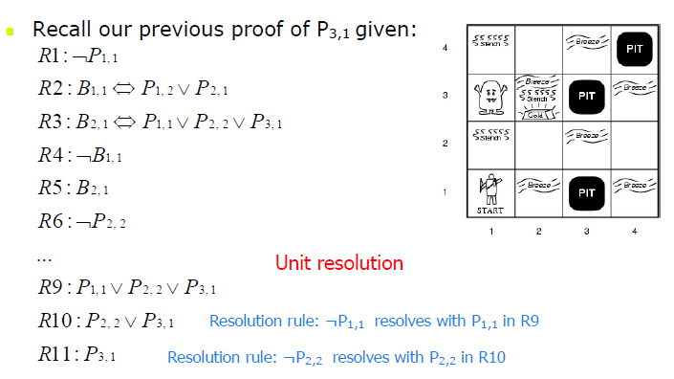
Example

Slide 43
First-Order Logic
First-order logic is another way of knowledge representation in artificial intelligence. It is an extension to propositional logic.
FOL is sufficiently expressive to represent the natural language statements in a concise way.
First-order logic is also known as Predicate logic or First-order predicate logic. First-order logic is a powerful language that develops information about the objects in a more easy way and can also express the relationship between those objects.
First-order logic (like natural language) does not only assume that the world contains facts like propositional logic but also assumes the following things in the world:
Objects: A, B, people, numbers, colors, wars, theories, squares, pits, wumpus, ......
Relations: It can be unary relation such as: red, round, is adjacent, or n-any relation such as: the sister of, brother of, has color, comes between
Function: Father of, best friend, third inning of, end of, ......
As a natural language, first-order logic also has two main parts:
Syntax
Semantics

Slide 44
Syntax and Semantics of First-Order Logic,
The syntax of FOL determines which collection of symbols is a logical expression in first-order logic. The basic syntactic elements of first-order logic are symbols. We write statements in short-hand notation in FOL.
Basic Elements of First-order logic:
Following are the basic elements of FOL syntax:
Constant 1, 2, A, John, Mumbai, cat,....
Variablesx, y, z, a, b,…
PredicatesBrother, Father, >,....
Functionsqrt, LeftLegOf, ....
Connectives∧, ∨, ¬, ⇒, ⇔
Equality==
Quantifier∀, ∃

Slide 45
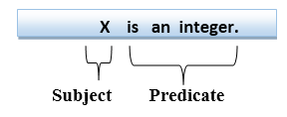
Atomic sentences:
Atomic sentences are the most basic sentences of first-order logic. These sentences are formed from a predicate symbol followed by a parenthesis with a sequence of terms.
We can represent atomic sentences as Predicate (term1, term2, ......, term n).
Example: Ravi and Ajay are brothers: => Brothers(Ravi, Ajay). Chinky is a cat: => cat (Chinky).
Complex Sentences:
Complex sentences are made by combining atomic sentences using connectives.
First-order logic statements can be divided into two parts:
Subject: Subject is the main part of the statement.
Predicate: A predicate can be
defined as a relation, which binds
two atoms together in a statement.
Consider the statement: "x is an integer.", it consists of two parts, the first part x is the subject of the statement and second part "is an integer," is known as a predicate.

Slide 46
Quantifiers in First-order logic:
A quantifier is a language element which generates quantification, and quantification specifies the quantity of specimen in the universe of discourse.
These are the symbols that permit to determine or identify the range and scope of the variable in the logical expression. There are two types of quantifier:
Universal Quantifier, (for all, everyone, everything)
Existential quantifier, (for some, at least one).

Slide 47
Universal Quantifier:
Universal quantifier is a symbol of logical representation, which specifies that the statement within its range is true for everything or every instance of a particular thing.
The Universal quantifier is represented by a symbol ∀, which resembles an inverted A.
If x is a variable, then ∀x is read as:
For all x
For each x
For every x.
Example:
All man drink coffee.
Let a variable x which refers to a cat so all x can be represented in UOD as below:

Slide 48
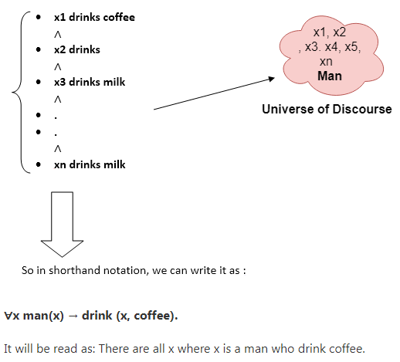

Slide 49
Knowledge Engineering in First-Order Logic
What is knowledge-engineering?
The process of constructing a knowledge-base in first-order logic is called as knowledge- engineering. In knowledge-engineering, someone who investigates a particular domain, learns important concept of that domain, and generates a formal representation of the objects, is known as knowledge engineer.
In this topic, we will understand the Knowledge engineering process in an electronic circuit domain, which is already familiar. This approach is mainly suitable for creating special-purpose knowledge base.

